Slide 1


Multiple linear regression for Classification
Multiple linear regression for Classification
“Use Regression in a binary classification problem”
Y à K = 2 Modalities

Slide 2

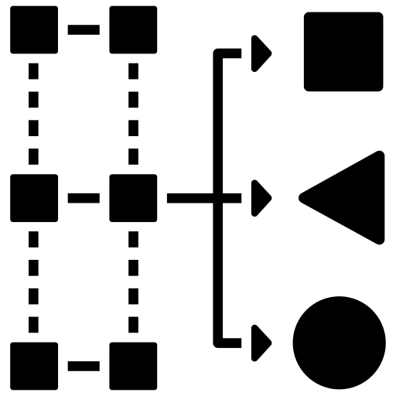
Predictive analysis: regression vs. Classification
Multiple Linear Regression
Predicting the values of a continuous variable

Slide 3
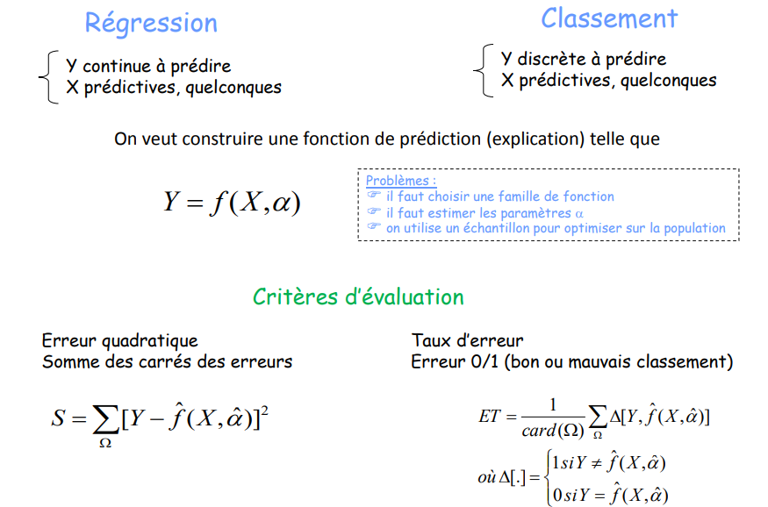
Predictive analysis: regression vs. Classification
Multiple Linear Regression
Regression
Classification
Y continues to predict
X predictive, any
Y discrete to be predicted
X predictive, any
We want to construct a prediction function (explanation) such that
Problems:
→ a family of functions must be chosen
→ we have to estimate the parameters
→ we use a sample to optimize on the population
Evaluation criteria
Squared error
Sum of squared errors
Error rate
Error 0/1 (good or bad ranking)

Slide 4
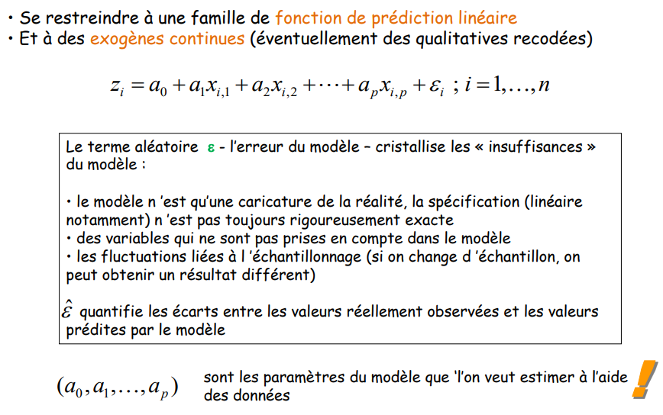
Multiple linear regression: reminder
Multiple Linear Regression
→ Restrict to a family of linear prediction functions
→ And to continuous exogenous (possibly recoded qualitative)
The random term ε - the error of the model - crystallizes the "insufficiencies" of the model:
→ the model is only a caricature of reality, the specification (linear in particular) is not always rigorously exact
→ variables that are not taken into account in the model
→ fluctuations linked to sampling (if we change the sample, we can obtain a different result)
ε quantifies the differences between the values actually observed and the values predicted by the model
are the parameters of the model that we want to estimate using the data

Slide 5
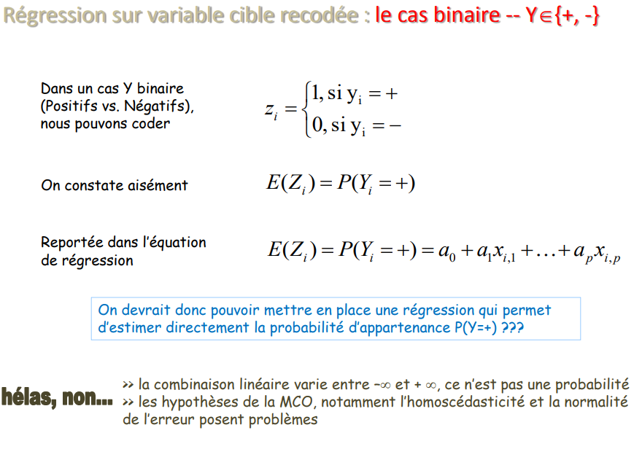
Multiple linear regression: reminder
Multiple Linear Regression
In a binary Y case
(Positive vs. Negative),
we can code
If
If
It is easy to see
Carried forward in the equation
regression equation
We should therefore be able to set up a regression that allows us to directly estimate the probability of membership P(Y=+) ???
Alas NO…
>> the linear combination varies between -inf and +inf, it is not a probability
>> the assumptions of OLS, in particular the homoscedasticity and the normality of the error, are problematic

Slide 6
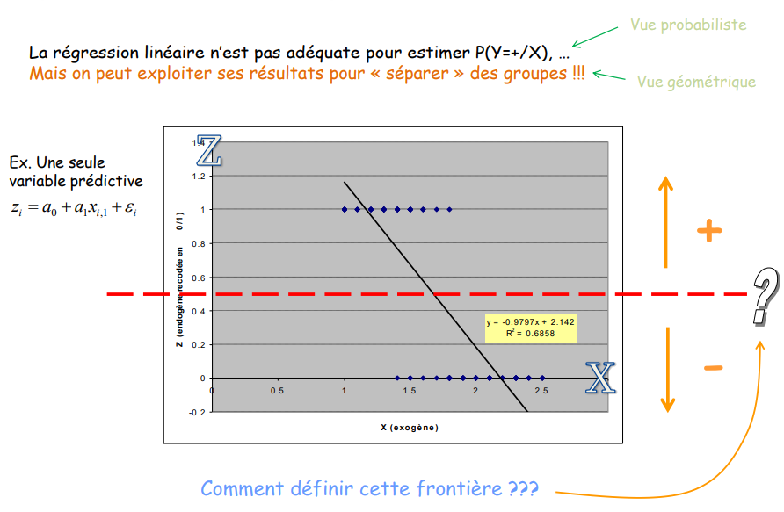
Regression: geometric point of view
Multiple Linear Regression
Probabilistic view
Linear regression is not adequate to estimate P(Y=+/X), ...
But we can exploit its results to "separate" groups
Geometric view
Ex. A single
predictor variable
How to define this border ???

Slide 7
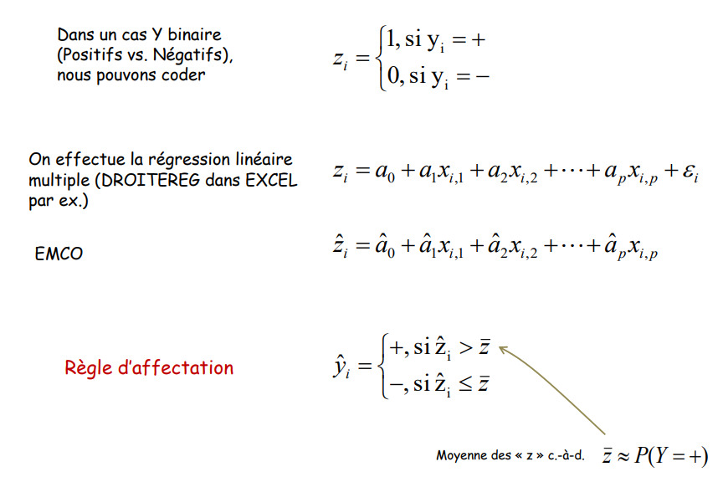
Regression: assignment rule with 0/1 coding
Multiple Linear Regression
In a binary Y case
(Positive vs. Negative),
we can code
If
If
We perform the linear regression
(e.g., DROITEREG in EXCEL
for example)
If
Assignment rule
If
Mean of the “Z’s” i.e.

Slide 8
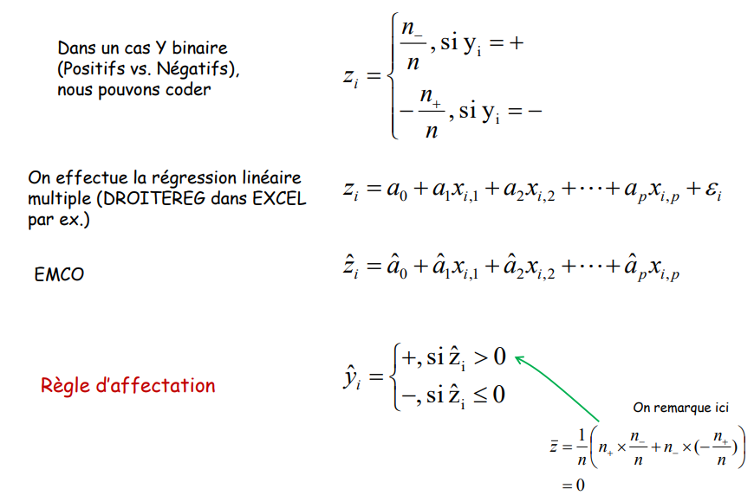
Regression: assignment rule with alternative coding
Multiple Linear Regression
In a binary Y case
(Positive vs. Negative),
we can code
If
If
We perform the linear regression
(e.g. DROITEREG in EXCEL
for example)
If
Assignment rule
If
We notice here that

Slide 9
Equivalence with discriminant analysis, Y at K = 2 Modalities
Multiple Linear Regression

Slide 10
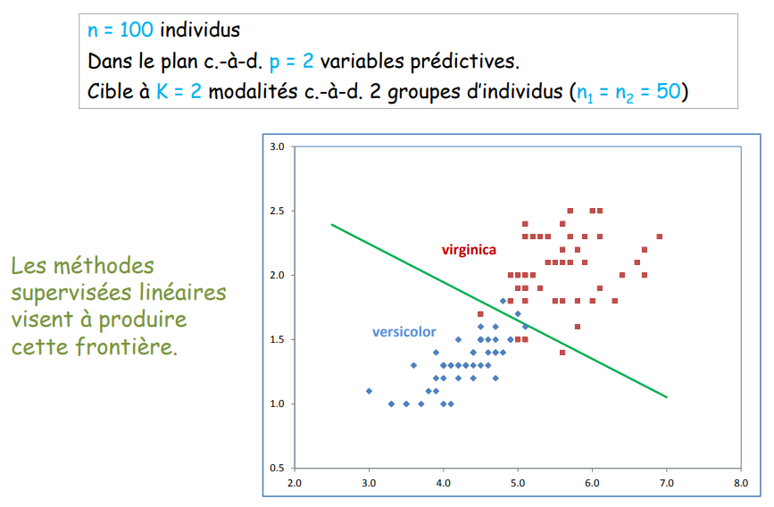
Discrimination: building a linear boundary
Multiple Linear Regression
n = 100 individuals In the design i.e., p = 2 predictor variables.
Target with K = 2 modalities i.e., 2 groups of individuals (n1 = n2 = 50)
Linear supervised linear methods aim to produce this boundary

Slide 11
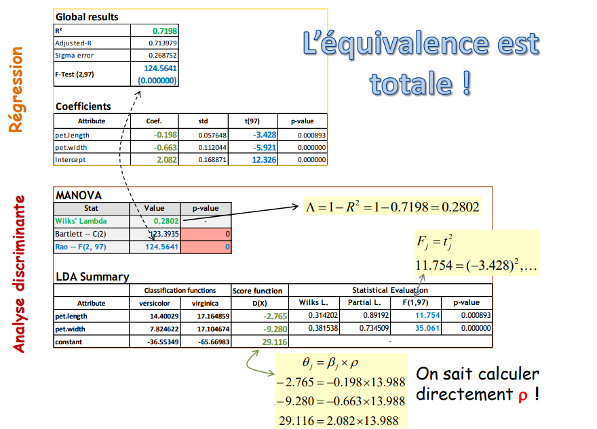
Comparing results
Multiple Linear Regression
the equivalence is total !
Regression
Discriminant analysis
We can calculate directly p !

Slide 12
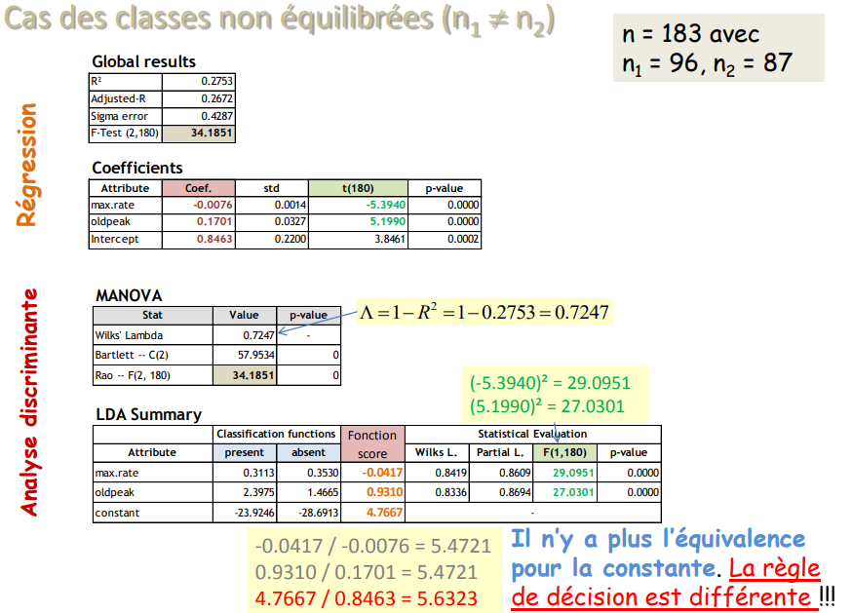
Case of unbalanced classes (n1 != n2)
Multiple Linear Regression
Regression
Discriminant analysis
There is no more equivalence for the constant. The rule of decision is different !!!

Slide 13
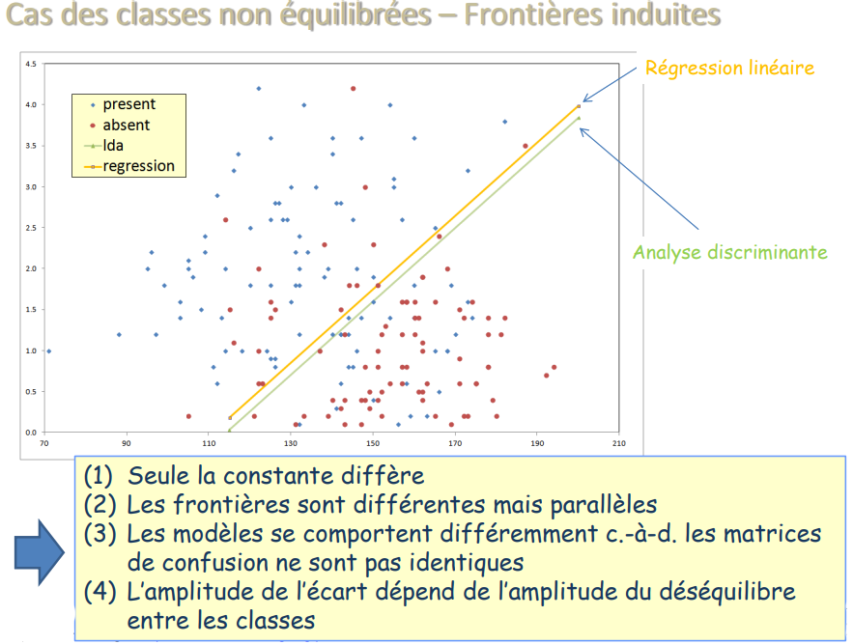
Case of unbalanced classes - Induced borders
Multiple Linear Regression
Linear Regression
Discriminant analysis
(1) Only the constant differs
(2) The boundaries are different but parallel
(3) The models behave differently, i.e., the confusion matrices are not identical
(4) The magnitude of the difference depends on the magnitude of the imbalance between the classes

Slide 14
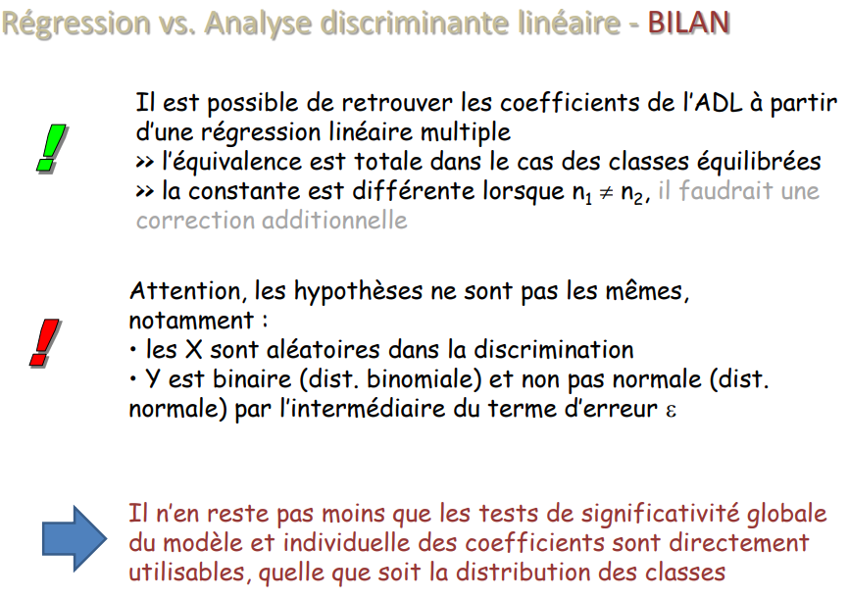
Case of unbalanced classes - Induced borders
Multiple Linear Regression
It is possible to find the coefficients of the LDA from
a multiple linear regression
>> the equivalence is total in the case of balanced classes
>> the constant is different when n1 != n2 it would require an additional correction
Attention, the assumptions are not the same, in particular:
→ the X's are random in the discrimination
→ Y is binary (binomial dist.) and not normal (normal dist. normal) through the error term ε
Nevertheless, the tests of global significance of the model and individual of the model and individual coefficients are directly usable, whatever usable, whatever the distribution of the classes

Slide 15

Comparing Methods
Multiple Linear Regression
Regression for classification
Linear Discriminant Analysis
Logistic Regression

Slide 16
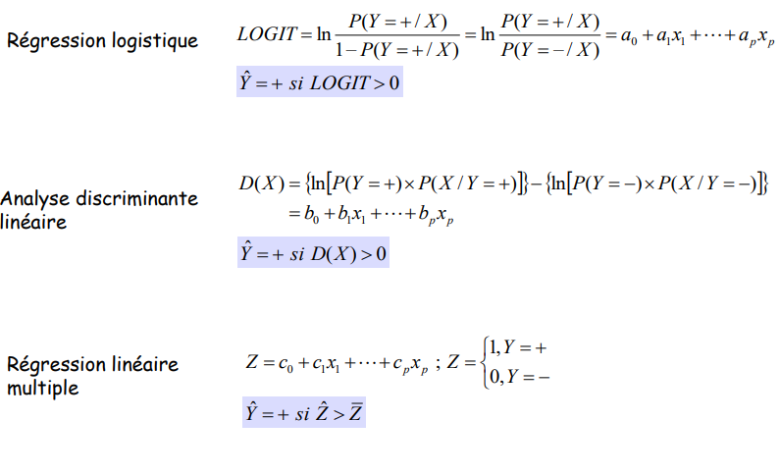
Three linear separators (Logistic Reg., Discriminant Analysis, Linear Reg.)
Multiple Linear Regression
Logistic regression
Discriminant analysis linear
Linear regression multiple

Slide 17
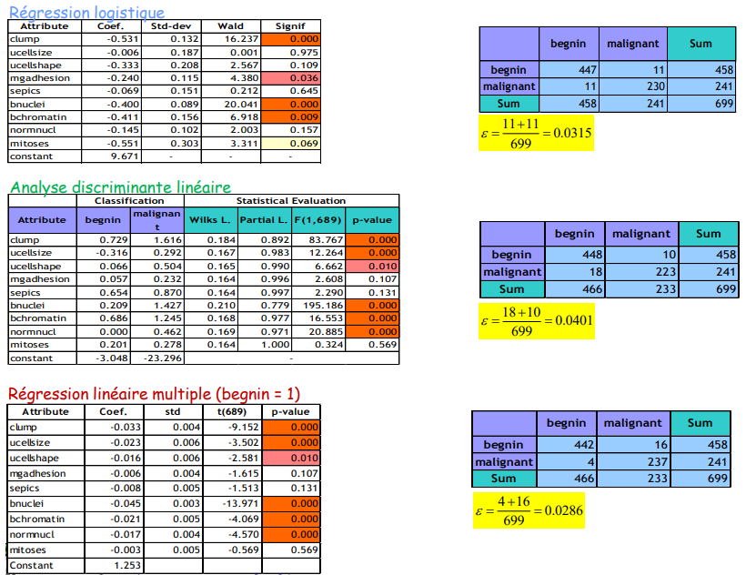
BREAST file (Y binary "cancer", 9 continuous descriptors) Evaluation in re-substitution
Multiple Linear Regression
Logistic Regression
Linear discriminant analysis
Multiple linear regression (benign = 1)

Slide 18
Conclusion
Multiple Linear Regression
IT WORKS !
(in the binary case K = 2)

Slide 19
Conclusion
Multiple Linear Regression
Linear regression can be used for binary classification.
(2) From the point of view of statistical inference, it is debatable; from the geometric point of view, it holds.
(3) In the binary case, there is an equivalence with discriminant analysis.
(4) It is total in the case of balanced classes (n1 = n2).
(5) The constant is different in the opposite case (n1 != n2). But the coefficients of the variables and the significance tests remain valid. One can use a regression variable selection program for discriminant analysis.
(6) There are different possible solutions for (K > 2). But they have different disadvantages (the boundaries between the classes can be inconsistent), and it inconsistent), and there is no more equivalence with the discriminant analysis.

